Slide 1
[Project Title]
[Presenter Name]
[Company]
ISO-NE Planning Advisory Committee Meeting
[Date]

Slide 2
Project Summary
Project Drivers
[Describe]
Alternatives Considered
Alternative | Description | Cost Estimate
Alternative 1 | (Base Alternative) [Summarize scope] | [$X.X M]
Alternative 2 | [Summarize scope] | [$X.X M]
Alternative 3 | [Summarize scope] | [$X.X M]
Preferred Alternative
Alternative | Reason for Recommendation | Cost Estimate
Alternative [X] | [Describe] | [$X.X M] -25%/+50%

Slide 3
Outline
Background Information
Project Needs and Drivers
Solution Alternatives
Selection of Preferred Solution
Schedule and Contact Information

Slide 4
Background Information
[Line XXX]
Key Details
Location | From: [Station], [Town], [State] To: [Station], [Town], [State]
Line length | ___ miles
Operating Voltage | ___ kV
Age and upgrade history | Originally constructed in ___ [No significant upgrades or rebuilds]
Prior PAC presentations | [List]
Existing Structures
Material | Configuration | Number | Avg. age
[Line Section 1]
[Wood] | [H-frame & Angle Structures] | [count] | [X] years
[Steel] | [H-frame & angle structures] | [count] | [X] years
[Steel] | [Single-circuit lattice tower] | [count] | [X] years
Existing Conductor
Type | Length | Avg. age
[Line Section 1]
[Type] | [x.x] miles | [X] years
[Type] | [x.x] miles | [X] years

Slide 5
Background Information
Maps and Diagrams

Slide 6
Project Needs and Drivers
Structure Concerns
Structure Concerns
Primary Concerns
Wood structure rot and decay | Recent inspections performed in [years] have identified [X] wood structures with woodpecker damage, pole top rot, cracked crossarms, splitting poles, and other forms of decay These structures must be replaced to maintain reliability and ensure ongoing integrity of the line Affected structures average [X] years old and are reaching the end of the typical useful life for [XXX kV] natural wood structures ([XX] years)
Steel lattice structure deterioration | Elaborate similar to above
Secondary concerns
None
 | Summary of Current Structure Grades
Category | Recommended Action | Number of structures
A | No replacement required due to deterioration | X
B | Consider replacement in conjunction with other structure replacements | X
C | Initiate planned structure replacement project or Replace as part of upcoming structure replacement project | X
D | Replace immediately (emergency replacement) | X
Total |  | X

Slide 7
Project Needs and Drivers
[subtitle]
[Insert inspection photos or other information]
[Change slide subtitle for different needs/drivers]

Slide 8
Project Needs and Drivers
Conductors
Conductor Concerns
Primary Concerns
[Issue] | [Description]
[Issue] | [Description]
Secondary Concerns
[Issue] | [Description]
[Discussion and Additional Information]

Slide 9
Project Needs and Drivers
Insulators
Insulator Concerns
Primary Concerns
[Issue] | [Description]
[Issue] | [Description]
Secondary Concerns
[Issue] | [Description]
Discussion and Additional Information

Slide 10
Project Needs and Drivers
Shield Wires
Shield Wire Concerns
Primary Concerns
[Issue] | [Description]
[Issue] | [Description]
Secondary Concerns
[Issue] | [Description]
Discussion and Additional Information

Slide 11
Project Needs and Drivers
Telecommunications
Telecommunication Needs
Primary Concerns
[Issue] | [Description]
[Issue] | [Description]
Secondary Concerns
[Issue] | [Description]
Discussion and Additional Information

Slide 12
Project Needs and Drivers
System Planning
Planning Concerns
Primary Concerns
[Issue] | [Description]
[Issue] | [Description]
Secondary Concerns
[Issue] | [Description]
Discussion and Additional Information

Slide 13
Project Needs and Drivers
Operations
Operational Concerns
Primary Concerns
[Issue] | [Description]
[Issue] | [Description]
Secondary Concerns
[Issue] | [Description]
Discussion and Additional Information

Slide 14
Project Needs and Drivers
Other Concerns
Other Concerns
Primary Concerns
[Issue] | [Description]
[Issue] | [Description]
Secondary concerns
[Issue] | [Description]
Discussion and Additional Information

Slide 15
Project Needs and Drivers
Items Not of Concern on this Line
Issue | Status
Structures | [discuss why this is not a concern with this line]
Conductors | [discuss why this is not a concern with this line]
Insulators | [discuss why this is not a concern with this line]
Shield Wire | [discuss why this is not a concern with this line]
Telecommunication | [discuss why this is not a concern with this line]
Planning | [discuss why this is not a concern with this line]
Operational | [discuss why this is not a concern with this line]

Slide 16
Previous Asset Management and Maintenance Strategies
New Addition Nov 2025
Preventative Maintenance and Other Practices
Issue | Status
Structures [if project driver] | [Prior maintenance and why these or other actions are not practical for additional life extension]
Conductors [if project driver] | [Prior maintenance and why these or other actions are not practical for additional life extension]
Insulators [if project driver] | [Prior maintenance and why these or other actions are not practical for additional life extension]
Shield Wire [if project driver] | [Prior maintenance and why these or other actions are not practical for additional life extension]

Slide 17
Review of Relevant Transmission Studies
Recent Transmission Studies
Was this line overloaded in recent Attachment K studies (Reliability Needs Assessments, Longer-Term Transmission Studies, etc.) or other recent studies?
[Yes or No. If yes, detail scenarios and resulting overloads]
Have modifications or upgrades to this line been identified as potential solutions in any of those studies?
[Yes or No. If yes, describe the potential modifications or upgrades such as reconductoring, rebuilding, increasing voltage level, etc.]

Slide 18
Evaluated Solution Alternatives
[Alternative Number]
[Alternative Name]
Description | [Describe]
Primary Needs Addressed | [Structure, Conductor, Etc]
Secondary Needs Addressed | [Structure, Conductor, Etc]
Advanced transmission technologies to be considered | [Advanced Conductors, Dynamic Line Ratings, Power Flow Controllers, Other]
Cost Estimate and Accuracy | $XM (+200% / -50%)
Impact on transmission needs or concerns from recent studies | [Describe if applicable]
Key standards or criteria affecting design if different than current design | [NESC, etc.] Or, “None – Alternative design is similar to existing design”

Slide 19
Comparative Analysis of Alternatives
Comparison
Key Criteria | Alternative 1 | Alternative 2 | Alternative 3
Addresses Primary Need(s) | [Yes/No]
Secondary Needs Addressed
Cost | $X.XM
Constructability concerns or advantages
Siting, Environmental and regulatory issues
[Expand table as needed]
Conclusions
[Describe]
Alternative [X] is the preferred alternative

Slide 20
Scope Summary for Preferred Solution
New Addition Nov 2025
Structure Characteristics
 |  | Per Unit
Primary structure configuration | H-Frame | N/A
Material | Steel | N/A
Number of Structure Replacements (est) | 25 | 2.5 per mile
[Other information]
Additional Scope Details
 | Total
Miles of ROW Affected | 10 miles
Miles of shield wire replacement | None
Miles of conductor replacement | None
ADSS Substation Connections | None
[Other Information]
Cost Breakdown Details [Modify line items as needed for specific projects]
 | Cost | Per Unit Cost
Structure Replacements | $X | $X/structure
Reconductoring / Shield Wire [optional] | $X | $X/mile
Access costs [optional] | $X | $X/mile
Other costs (engineering, contingency, etc.) [optional] | $X
Total Cost | $X
Key factors affecting costs

Slide 21
Schedule
Planned Schedule
Comment Deadline | December YY 2024
Follow-up PAC Presentation | [Date]
Start of Major Construction | QX 202X
Project in Service | QX 202X
Please submit any comments to pacmatters@iso-ne.com and:
Transmission Owner Contact
Contact Name | [Company Contact Name]
Contact Email Address | [Company Contact Email Address]

Slide 22
Appendix

Slide 23
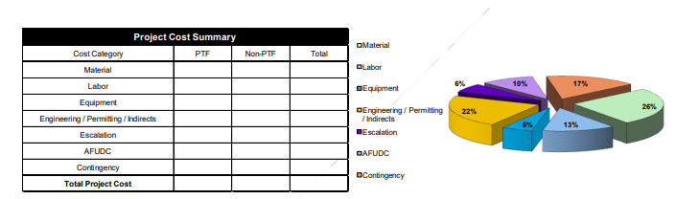
Additional Cost Detail
New Addition Nov 2025

Slide 24
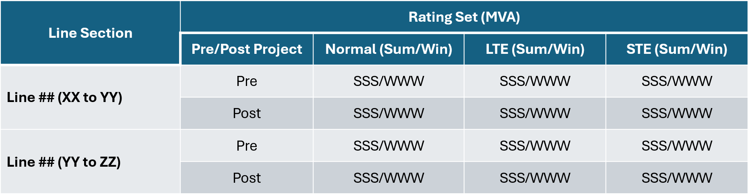
Preliminary Conductor Ratings*
Pre- and Post-Project Ratings for Alternative [X]
New Addition Nov 2025
Current and preliminary post-project conductor ratings are listed below – final post-project ratings may differ
[Include this slide only if capacity is potentially changing]
*Final circuit ratings may be limited due to associated substation equipment

